Slide 1
TENDER TOUCH
WEBSITE ON BABY CARE PRODUCTS
GUIDE NAME
STUDENT NAME
DR. A. ROSLIN DEEPA
ASSISTANT PROFESSOR
DEPARTMENT OF IT
V. MILLEE GUPTA
ROLL NO: 22BIT52
DEPARTMENT OF IT
THE AMERICAN COLLEGE
THE AMERICAN COLLEGE

Slide 2
ABSTRACT
“Tender Touch” is a web application where we can discover the perfect blend of care and convenience ensuring that every item supports your baby’s health, comfort and development. The product are crafted from purest and natural ingredient.
The online platform aims to streamline the shopping experience by offering selected range of baby care products. It provides a user-friendly platform. It contains multiple payment gateways that are secure.
By leveraging technology, this eccommerce site provides evolving needs to modern family. This website aims to educate and empower users by providing insightful content on the significance of products.

Slide 3
SYSTEM ANALYSIS
EXISTING SYSTEM
PROPOSED SYSTEM
Maintained manually
Most process is slow
Requires more time to manage the record of orders
Offers all kinds of products
Aims to make manual system into digital system
Helps admin to maintain the record of the orders
User-friendly navigation
Resposive chatbot

Slide 4
SYSTEM CONFIGURATION
HARDWARE CONFIGURATION
SOFTWARE CONFIGURATION
Processor : Intel(R) Core(TM) i3-1215U 1.20 GHz
RAM : 8.00 GB (7.69 GB usable)
Hard disk : 1TB
Front end : Html, css, javascript, bootstrap
Back end : Mysql, php
OS : Microsoft Windows 11, 64-bit
Server : Xampp
Web Browser : Chrome

Slide 5
MODULES
Home page
Products
User account
Admin dashboard
Shopping cart
Checkout

Slide 6
MODULE DESCRIPTIONS
Home Page :
Home page module typically provides a brief introduction to features and service on this website. This helps visitors quickly understand what the website offers and how they can access the different services or modules.
Products:
Product module highlights all of the products, helping users to understand what all items are available in the website and why they should explore it more.

Slide 7
User account:
User account module helps visitors understand why having an account on the website can enhance their shopping, preferences,etc. It provides an overview of benefits of creating and managing an user account for admin.
Admin dashboard:
Admin dashboard module provides interface that allows the website’s admin to manage various aspects such as products, users,orders and more. It provides admin some set of tools for managing the platform.

Slide 8
Shopping cart:
Shopping cart module allows users to add, view, modify and purchase products in their cart. This module is crucial for the website as it makes easier for the customer to manage their products before checkout.
Checkout:
Checkout module provides overview of reviewing their orders to proceed and select the payment method to complete the transaction.

Slide 9
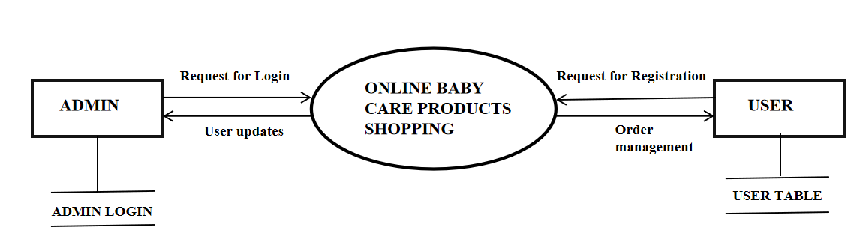
Data Flow Diagram - LEVEL ZERO

Slide 10
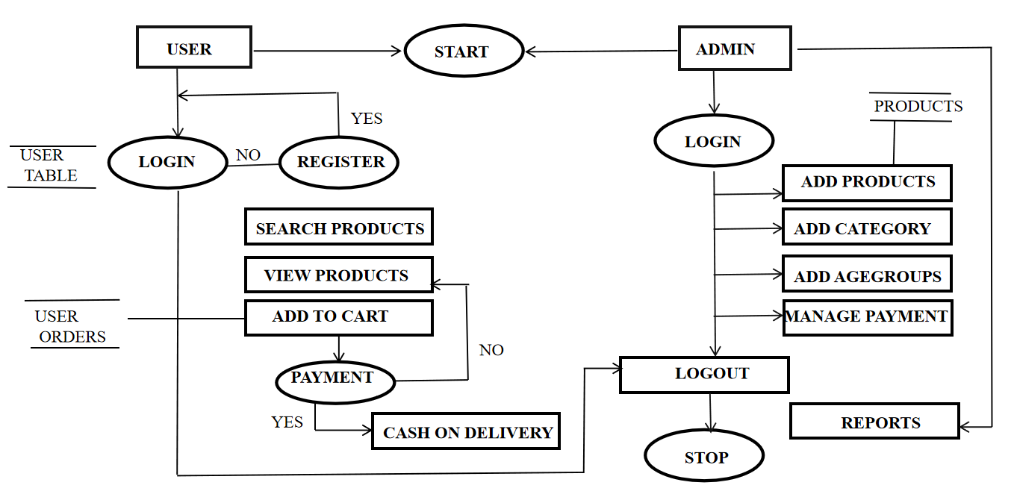
LEVEL 1

Slide 11
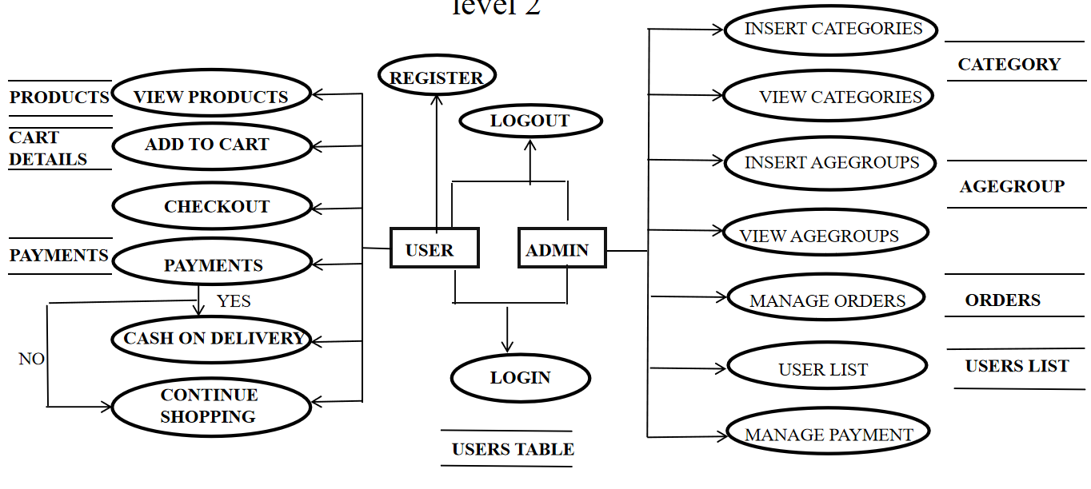

LEVEL 2

Slide 12
DATABASE TABLE DESIGN- PRODUCT TABLE
FIELD NAME | DATA TYPE | SIZE | CONSTRAINTS
Product Id | Int | 11 | Primary Key
Product Title | Varchar | 100 | Not null
Product description | Varchar | 255 | Not null
Product keywords | Varchar | 255 | Not null
Category Id | Int | 11 | Not null
Agegroup Id | Int | 11 | Not null
Product image1 | Varchar | 255 | Not null
Product image2 | Varchar | 255 | Not null
Product image3 | Varchar | 255 | Not null
Product price | Varchar | 100 | Not null
Date | timestamp | - | Not null
Status | Varchar | 100 | Not null

Slide 13
CATEGORY TABLE
FIELD NAME | DATA TYPE | SIZE | CONSTRAINTS
Category Id | Int | 11 | Primary Key
Category Title | Varchar | 100 | Not null
AGEGROUP TABLE
FIELD NAME | DATA TYPE | SIZE | CONSTRAINTS
Agegroup Id | Int | 11 | Primary Key
Agegroup Title | Varchar | 100 | Not null

Slide 14
USER TABLE
FIELD NAME | DATA TYPE | SIZE | CONSTRAINTS
User Id | Int | 11 | Primary Key
Username | Varchar | 100 | Not null
User email | Varchar | 100 | Not null
User password | Varchar | 255 | Not null
User image | Varchar | 255 | Not null
User IP | Varchar | 100 | Not null
User address | Varchar | 255 | Not null
User mobile | Varchar | 20 | Not null

Slide 15
CART DETAILS TABLE
FIELD NAME | DATA TYPE | SIZE | CONSTRAINTS
Product Id | Int | 11 | Primary Key
IP Address | Varchar | 255 | Not null
Quantity | Int | 100 | Not null
PENDING ORDER TABLE
FIELD NAME | DATA TYPE | SIZE | CONSTRAINTS
Order Id | Int | 11 | Primary Key
User Id | Int | 255 | Not null
Invoice number | Int | 255 | Not null
Product Id | Int | 11 | Not null
Quantity | Int | 255 | Not null
Order status | Varchar | 255 | Not null

Slide 16
SYSTEM TESTING
A primary purpose for testing is to detect software failures so that defects may be uncovered and corrected.

Slide 17
IMPLEMENTATION
Index.php
<!DOCTYPE html>
<html lang="en">
<head>
<meta charset="utf-8">
<meta http-eqiv="X-UA-Compatible" content="IE-edge">
<meta name="viewport" content="width=device-width, initial-scale=1.0">
<title>Ecommerce website using PHP and MYSQL</title>
<!-- bootstrap CSS link -->
<link href="https://cdn.jsdelivr.net/npm/bootstrap@5.1.3/dist/css/bootstrap.min.css" rel="stylesheet" integrity="sha384-1BmE4kWBq78iYhFldvKuhfTAU6auU8tT94WrHftjDbrCEXSU1oBoqyl2QvZ6jIW3" crossorigin="anonymous">
<!-- font awesome link -->
<link rel="stylesheet" href="https://cdnjs.cloudflare.com/ajax/libs/font-awesome/6.6.0/css/all.min.css" integrity="sha512-Kc323vGBEqzTmouAECnVceyQqyqdsSiqLQISBL29aUW4U/M7pSPA/gEUZQqv1cwx4OnYxTxve5UMg5GT6L4JJg==" crossorigin="anonymous" referrerpolicy="no-referrer" />

Slide 18
<!-- css file -->
<link rel="stylesheet" href="style.css">
</head>
<body>
<!-- navbar -->
<div class="container-fluid p-0">
<!-- first child -->
<nav class="navbar navbar-expand-lg navbar-light" style="background-color: #7851A9;">
<div class="container-fluid">
<img src="./images/logo.png" alt="" class="logo">
<button class="navbar-toggler" type="button" data-bs-toggle="collapse" data-bs-target="#navbarSupportedContent" aria-controls="navbarSupportedContent" aria-expanded="false" aria-label="Toggle navigation">
<span class="navbar-toggler-icon"></span>
</button>
<div class="collapse navbar-collapse" id="navbarSupportedContent">
<ul class="navbar-nav me-auto mb-2 mb-lg-0">
<li class="nav-item">
<a class="nav-link active" aria-current="page" href="/">Home</a>
</li>
<li class="nav-item">
<a class="nav-link" href="#">Products</a>
</li>

Slide 19
<li class="nav-item">
<a class="nav-link" href="#">Register</a>
</li>
<li class="nav-item">
<a class="nav-link" href="#">Contact</a>
</li>
<li class="nav-item">
<a class="nav-link" href="#"><i class="fa-solid fa-cart-shopping"></i><sup>1</sup></a>
</li>
<li class="nav-item">
<a class="nav-link" href="#">Total Price:100/- </a>
</li>
</ul>
<form class="d-flex">
<input class="form-control me-2" type="search" placeholder="Search" aria-label="Search">
<button class="btn btn-outline-dark" type="submit">Search</button>
</form>
</div>
</div>
</nav>

Slide 20
<!-- second child -->
<nav class="navbar navbar-expand-lg navbar-dark bg-dark">
<u1 class="navbar-nav me-auto">
<li class="nav-item">
<a class="nav-link" href="#">Welcome Guest</a>
</li>
<li class="nav-item">
<a class="nav-link" href="#">Login</a>
</li>
</u1>
</nav>
<!-- third child -->
<div class="bg-light">
<h3 class="text-center">BABY CARE</h3>
<p class="text-center">Where smiles and giggles never fade</p>
</div>
<!-- fourth child -->
<div class="row">
<div class="col-md-10">

Slide 21
<!-- products -->
<div class="row">
<div class="col-md-4 mb-2">
<div class="card">
<img src="./images/product1.jpg" class="card-img-top" alt="...">
<div class="card-body">
<h5 class="card-title">Card title</h5>
<p class="card-text">Some quick example text to build on the card title and make up the bulk of the card's content.</p>
<a href="#" class="btn btn-info">Add to cart </a>
<a href="#" class="btn btn-secondary">View more</a>
</div>
</div>
</div>
<div class="col-md-4 mb-2">
<div class="card">
<img src="./images/hani.jpeg" class="card-img-top" alt="...">
<div class="card-body">
<h5 class="card-title">Card title</h5>
<p class="card-text">Some quick example text to build on the card title and make up the bulk of the card's content.</p>
<a href="#" class="btn btn-info">Add to cart </a>
<a href="#" class="btn btn-secondary">View more</a>

Slide 22
</div>
</div>
</div>
<div class="col-md-4 mb-2">
<div class="card">
<img src="./images/product3.jpg" class="card-img-top" alt="...">
<div class="card-body">
<h5 class="card-title">Card title</h5>
<p class="card-text">Some quick example text to build on the card title and make up the bulk of the card's content.</p>
<a href="#" class="btn btn-info">Add to cart </a>
<a href="#" class="btn btn-secondary">View more</a>
</div>
</div>
</div>
<div class="col-md-4 mb-2">
<div class="card">
<img src="./images/product3.jpg" class="card-img-top" alt="...">
<div class="card-body">
<h5 class="card-title">Card title</h5>
<p class="card-text">Some quick example text to build on the card title and make up the bulk of the card's content.</p>
<a href="#" class="btn btn-info">Add to cart </a>

Slide 23
<a href="#" class="btn btn-secondary">View more</a>
</div>
</div>
</div>
<div class="col-md-4 mb-2">
<div class="card">
<img src="./images/product2 (6).jpg" class="card-img-top" alt="...">
<div class="card-body">
<h5 class="card-title">Card title</h5>
<p class="card-text">Some quick example text to build on the card title and make up the bulk of the card's content.</p>
<a href="#" class="btn btn-info">Add to cart </a>
<a href="#" class="btn btn-secondary">View more</a>
</div>
</div>
</div>
<div class="col-md-4 mb-2">
<div class="card">
<img src="./images/hani.jpeg" class="card-img-top" alt="...">
<div class="card-body">
<h5 class="card-title">Card title</h5>
<p class="card-text">Some quick example text to build on the card title and make up the bulk of the card's content.</p>

Slide 24
<a href="#" class="btn btn-info">Add to cart </a>
<a href="#" class="btn btn-secondary">View more</a>
</div>
</div>
</div>
</div>
</div>
<div class="col-md-2 bg-dark p-0">
<!-- age groups to be dislplayed -->
<ul class="navbar-nav me-auto text-center">
<li class="nav-item" style="background-color: #7851A9;">
<a href="#" class="nav-link text-dark"><h4>Age Groups</h4></a>
</li>
<li class="nav-item">
<a href="#" class="nav-link text-light">0-4 months</a>
</li>
<li class="nav-item">
<a href="#" class="nav-link text-light">5-8 months</a>
</li>
<li class="nav-item">
<a href="#" class="nav-link text-light">8-12 months</a>
</li>

Slide 25
<li class="nav-item">
<a href="#" class="nav-link text-light">1-2 years</a>
</li>
<li class="nav-item">
<a href="#" class="nav-link text-light">3-5 years</a>
</li>
</ul>
<!-- categories to be displayed -->
<ul class="navbar-nav me-auto text-center">
<li class="nav-item" style="background-color: #7851A9;">
<a href="#" class="nav-link text-dark"><h4>Categories</h4></a>
</li>
<li class="nav-item">
<a href="#" class="nav-link text-light">categories1</a>
</li>
<li class="nav-item">
<a href="#" class="nav-link text-light">categories2</a>
</li>
<li class="nav-item">
<a href="#" class="nav-link text-light">categories3</a>
</li>

Slide 26
<li class="nav-item">
<a href="#" class="nav-link text-light">categories4</a>
<li class="nav-item">
<a href="#" class="nav-link text-light">categories5</a>
</li>
</ul>
</div>
</div>
<!-- last child -->
<div class="bg-black p-3 text-center text-light">
<p>ALL RIGHTS RESERVED &copy;- DESIGNED BY MILLEE</p>
</div>
</div>
<!-- bootstrap js link -->
<script src="https://cdn.jsdelivr.net/npm/bootstrap@5.1.3/dist/js/bootstrap.bundle.min.js" integrity="sha384-ka7Sk0Gln4gmtz2MlQnikT1wXgYsOg+OMhuP+IlRH9sENBO0LRn5q+8nbTov4+1p" crossorigin="anonymous"></script>
</body>
</html>

Slide 27
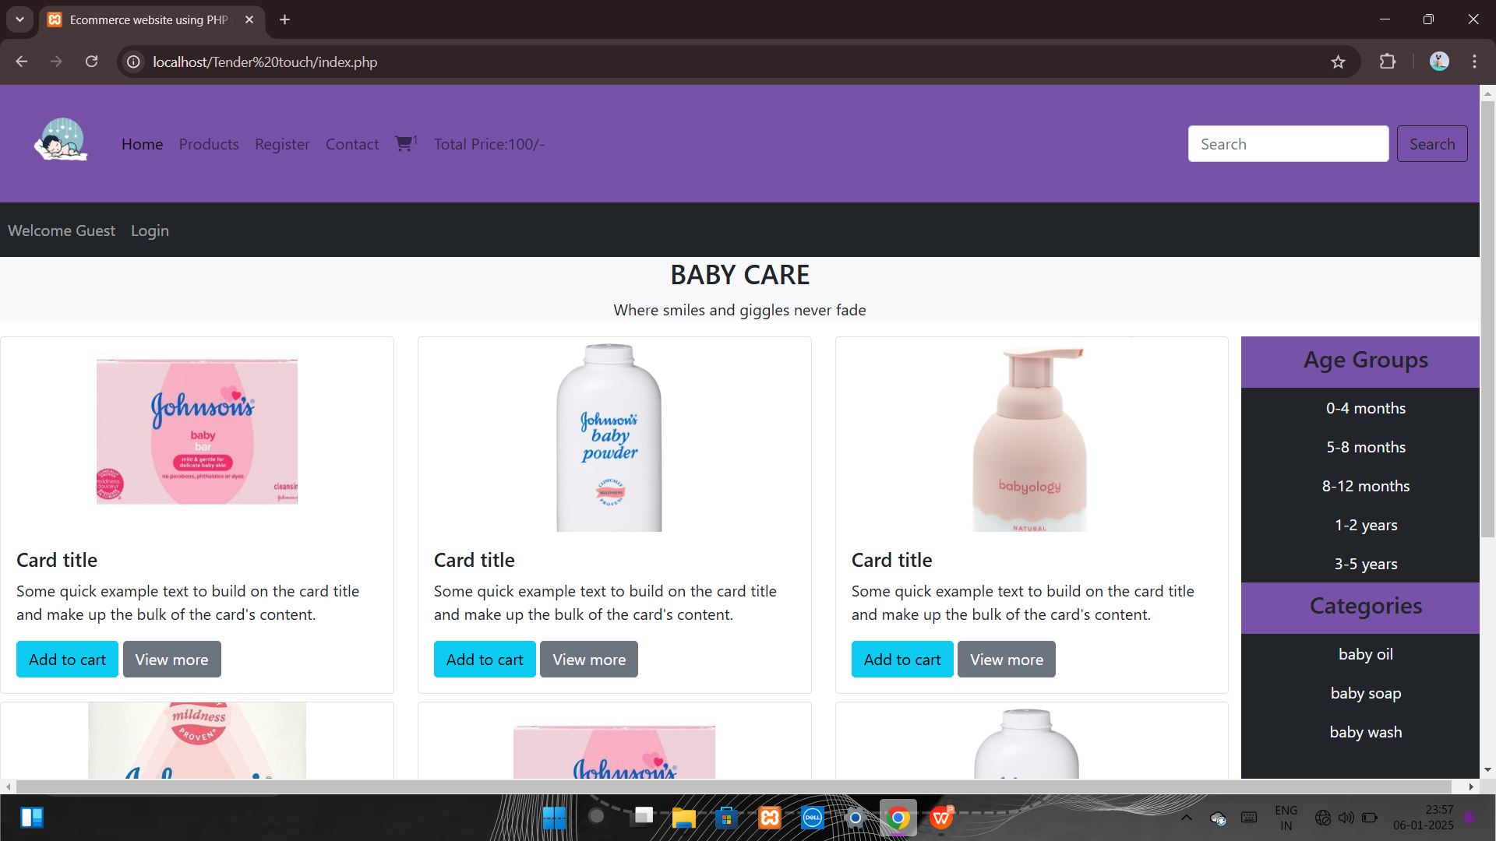
SCREENSHOTS

Slide 28
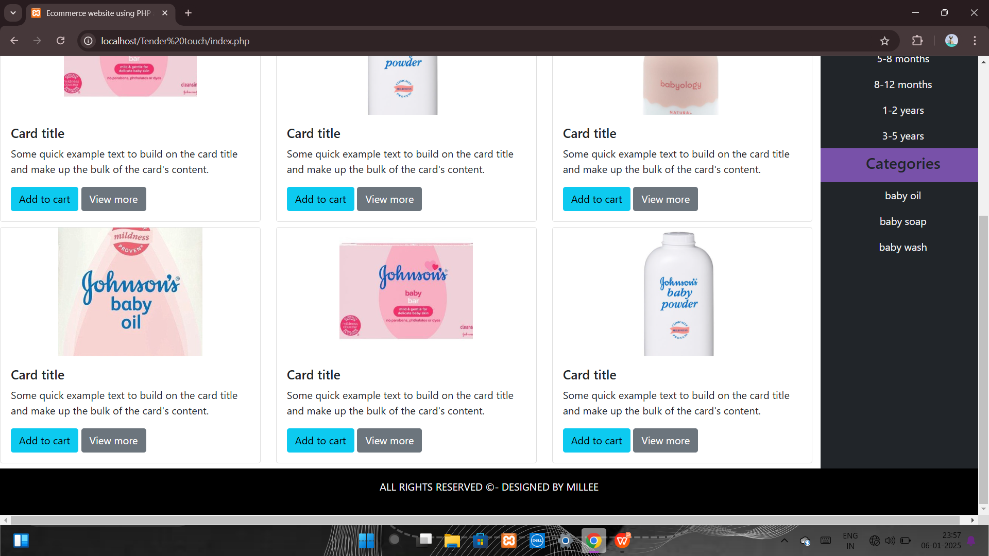

Slide 29
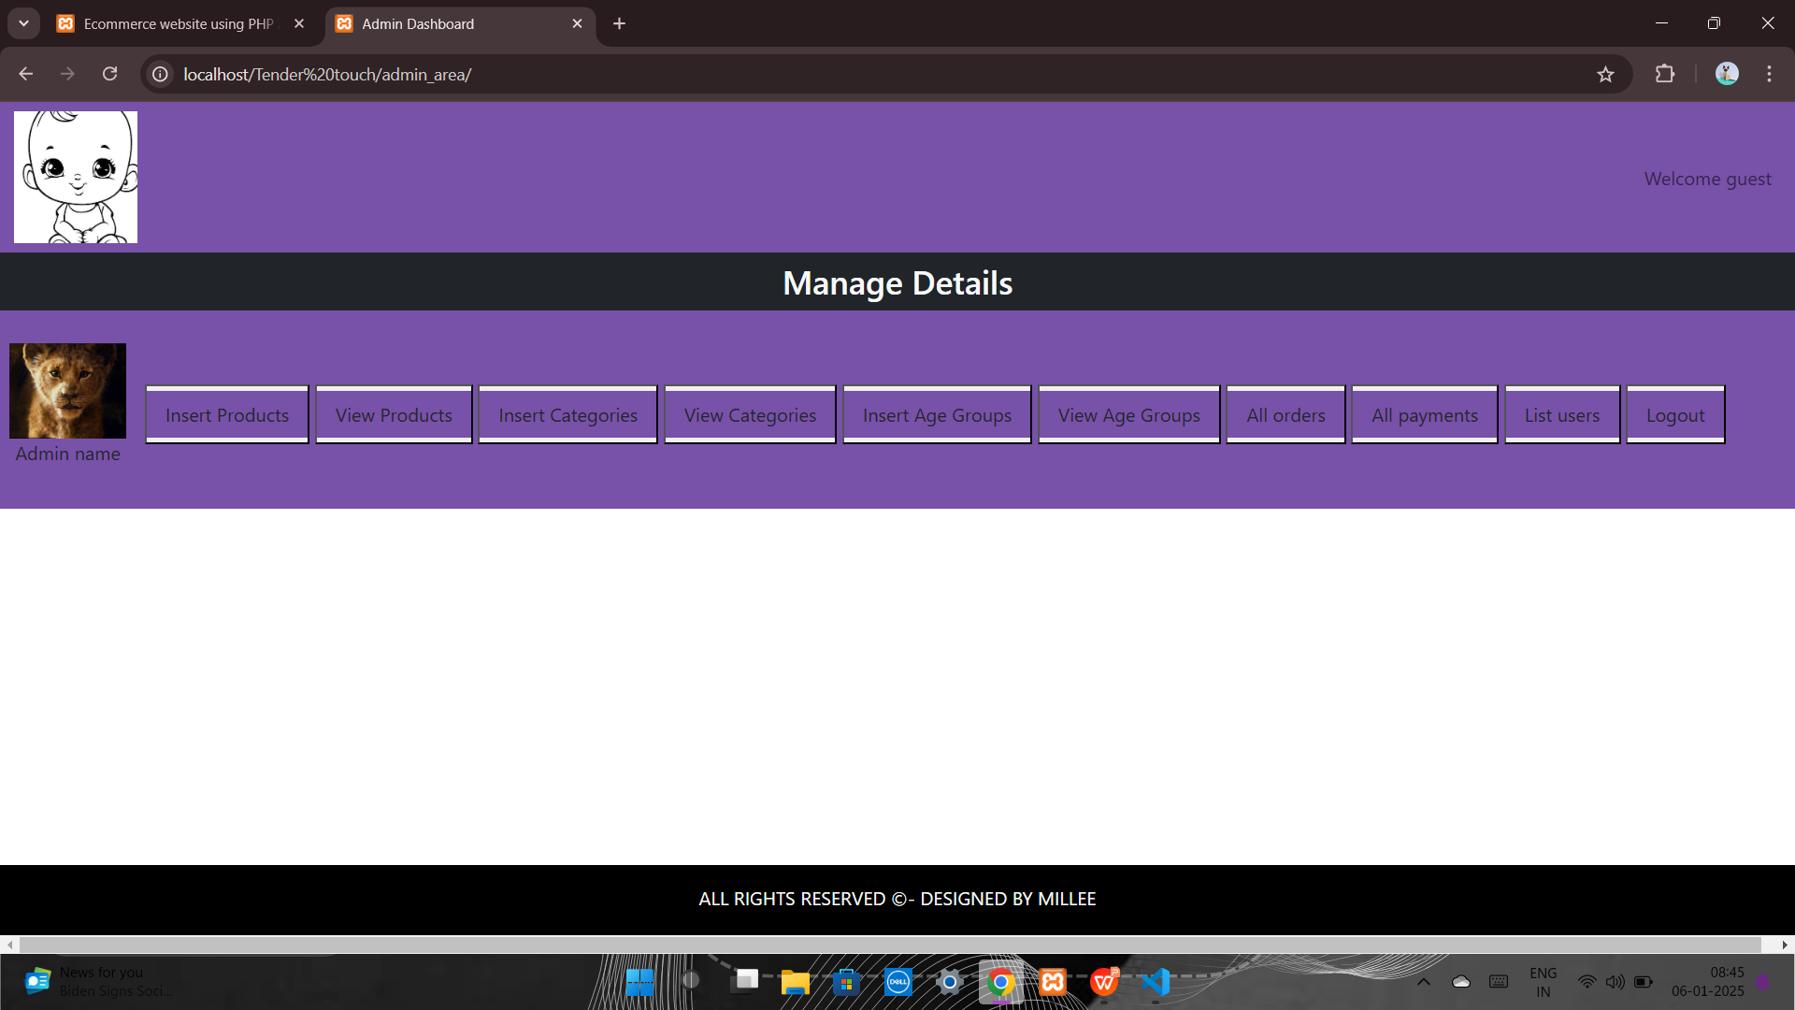

Slide 30
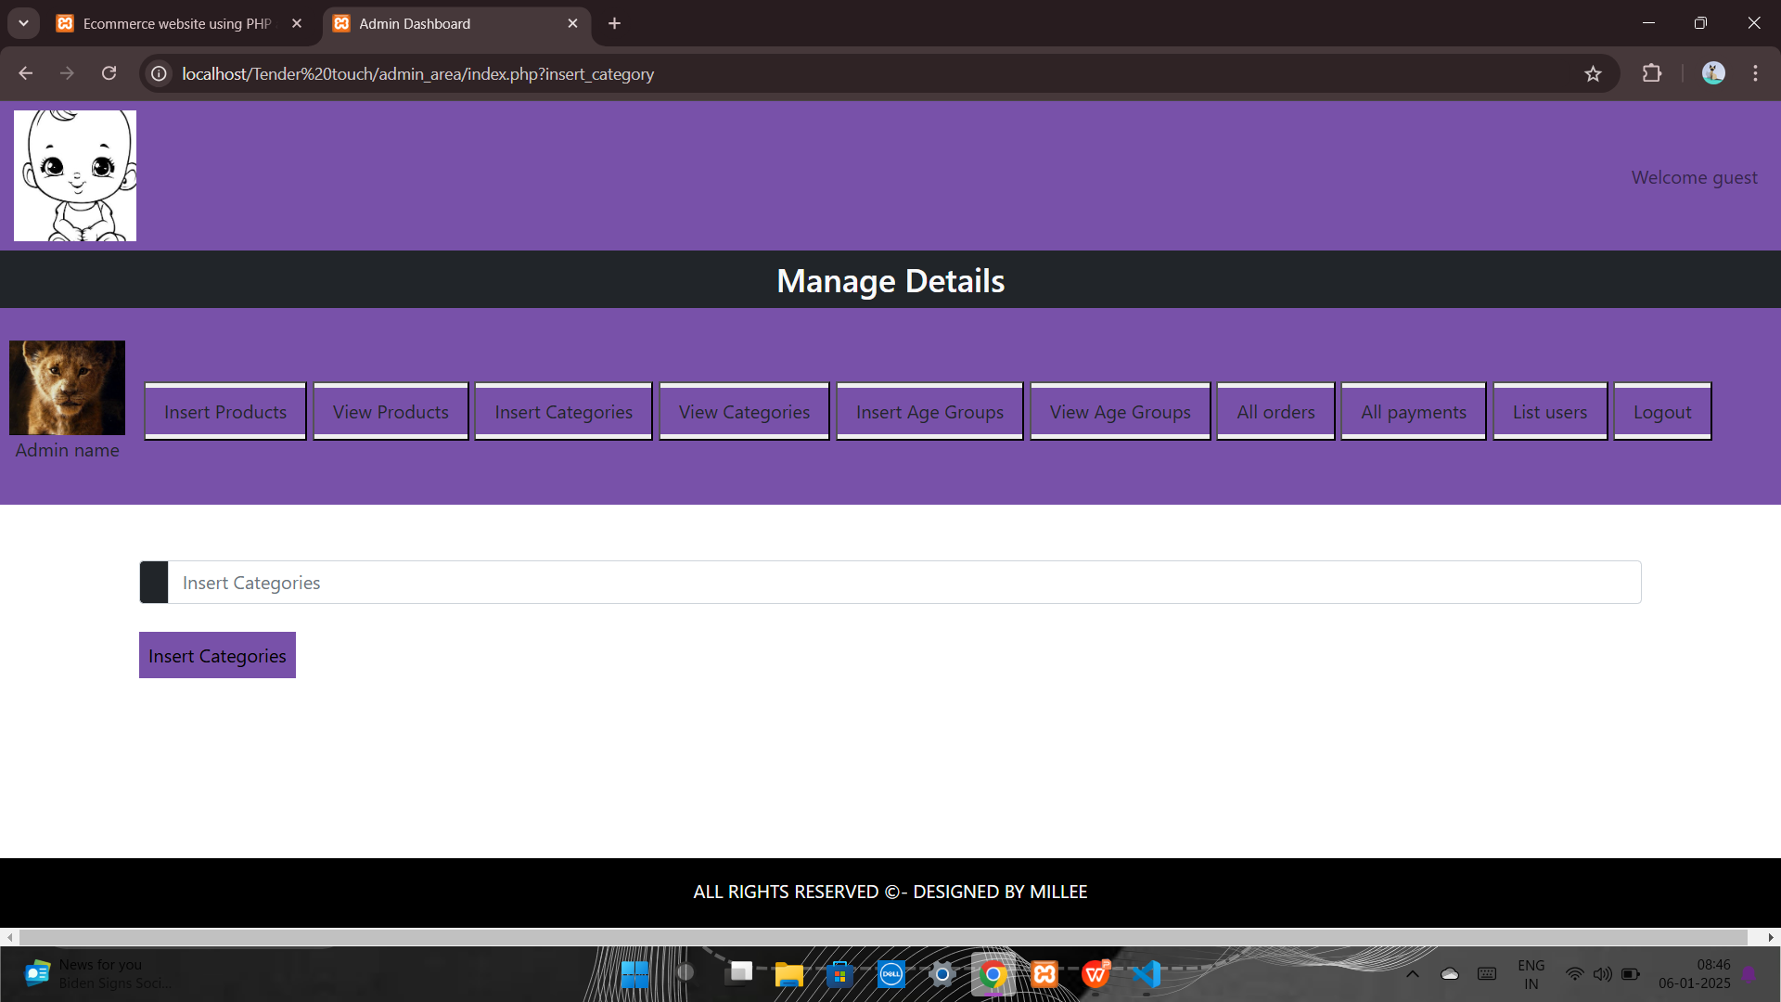

Slide 31
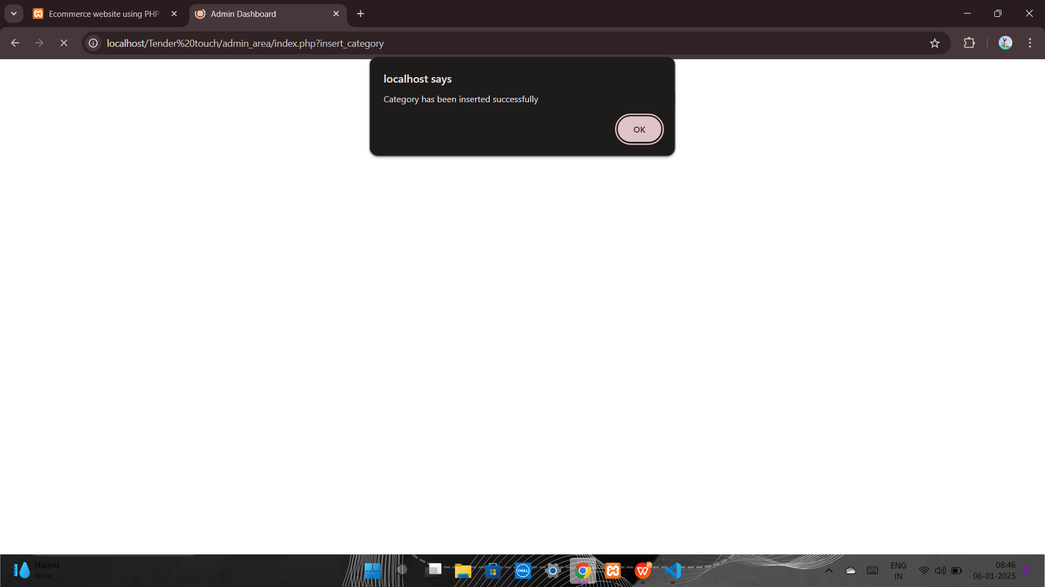

Slide 32


Slide 33
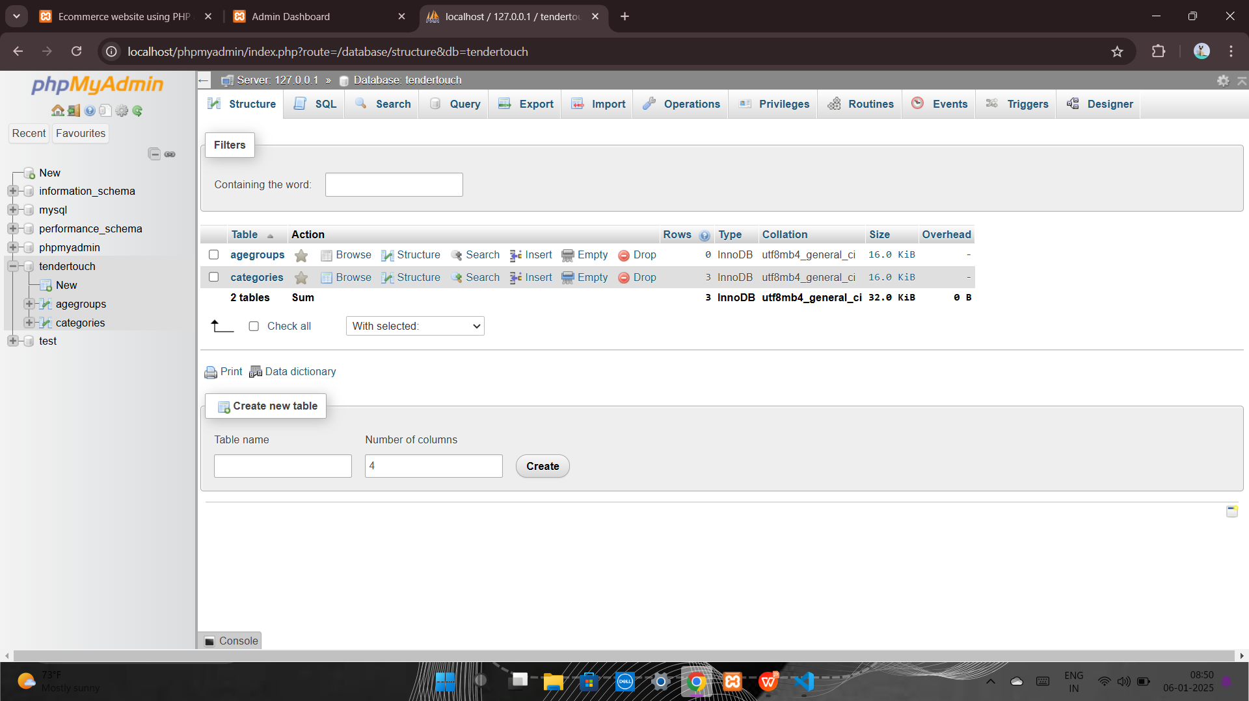

Slide 34
THANK YOU

